Slide 1
Monitoring and learning about transformation
Mark Stafford Smith, STAP
30th March 2023
Photo credit: sezer66, Shutterstock
Notes:
Welcome to this discussion about transformation, and what it needs to mean if we are targeting it in the GEF context.

Slide 2
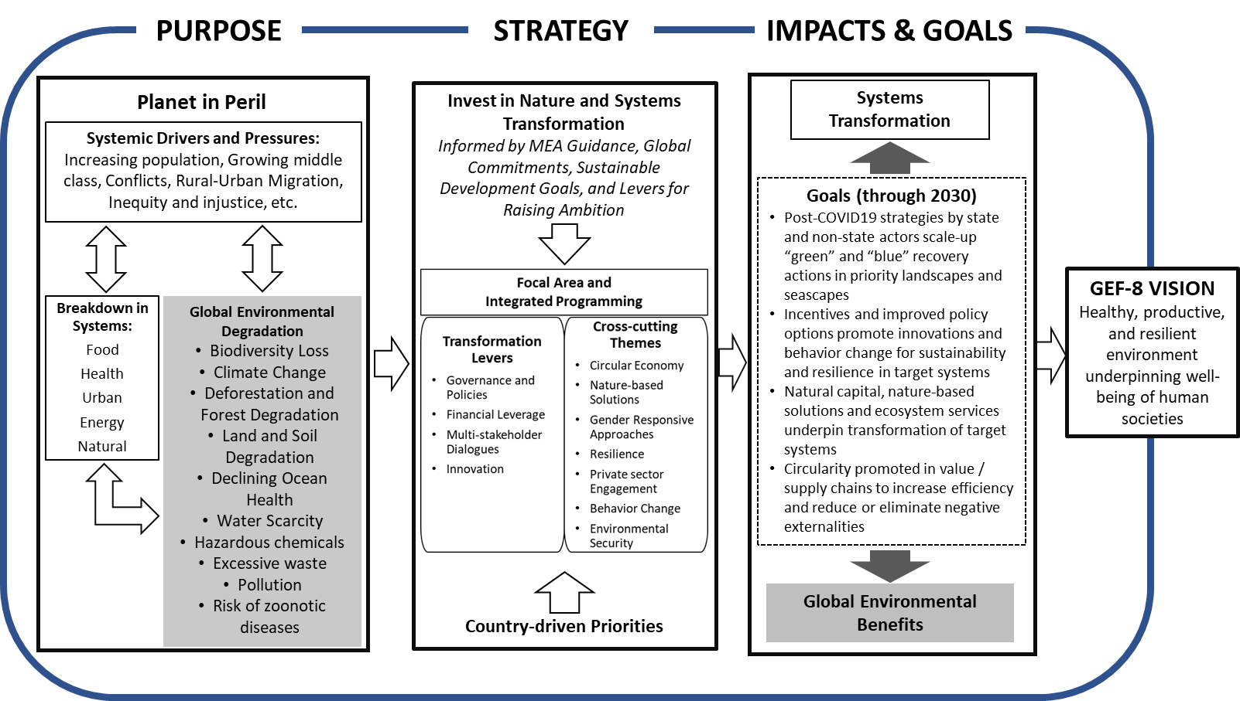
GEF-8 – levers for transformational change
Source: GEF-8 Strategic Positioning Framework
Notes:
This figure is probably familiar to you, GEF-8’s theory of change, aimed firmly at systems transformation, and highlighting four levers to assist this transformation in the systems that GEF-8 targets. The levers here, that we will return to, are: governance and policies; financial leverage, multi-stakeholder dialogues; and innovation.

Slide 3
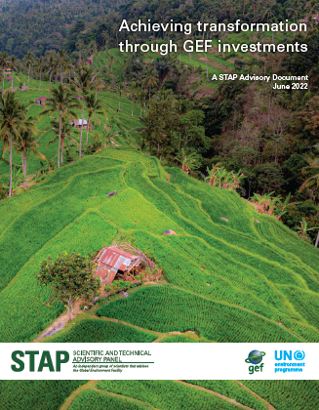
Designing for transformation
A transformative investment should “lead to enduring change at a sufficient scale to deliver a step improvement in GEBs”
Should this investment be transformative?
If so, is its goal sufficiently transformative?
If so, is the proposed logic for achieving the goal credible?
https://www.stapgef.org/resources/advisory-documents/achieving-transformation-through-gef-investments
Notes:
So there is no doubt that GEF-8 is trying to ramp up the rhetoric and reality around transformation. In support, STAP released a paper last year which suggested we need to define what this means, since transformation can happen at any scale, from the farm to the planet. For the GEF, with its mandate in support of the global conventions, STAP suggested a transformative investment really has to be seen as one that leads to enduring change at a sufficient scale to deliver a step improvement in one or more GEBs at this global scale. We provided a number of example pathways for how this can occur, which you can find in the paper’s Annex A.
The paper then suggested that we can screen investments for their transformative potential by asking three questions, that are elaborated in Figure 1 in the paper:
1. Is it in fact intended to be transformative? This is an important question related to GEF’s overall appetite for taking risks across its portfolio in order to achieve change. Not every individual project can change the world; but there is no doubt that GEF expects every IP to be transformative, so at least at the integrated program level the answer to this is firmly yes. And many of their projects must at least have some pathway by which they may contribute to such transformation.
2. If so, is the investment goal sufficiently ambitious to meet our definition of transformative in the GEF context? Here we need to ask whether it is aiming at one of the global transformation pathways suggested in the paper, such as a whole value chain or a biome with global implications with respect to GEBs, or something of equivalent significance.
3. If it is, then is the proposed logic for achieving the transformative goal credible?
[These criteria are very similar to those articulated by GIZ in their work which we will hear a bit more of later – that an “…overt intent to transform, an explicit approach to scaling, and a focus on the durability of the new system (as well as declining resilience in the old system) are mandatory criteria for an investment claiming to be transformative…” though the focus on the declining old system is an important additional idea.]
This takes us to asking how transformation occurs, and hence to metrics.

Slide 4
To be transformative…
“…overt intent to transform, an explicit approach to scaling, and a focus on the durability of the new system (as well as declining resilience in the old system) are mandatory criteria for an investment claiming to be transformative…” (STAP, GIZ)
Notes:
Because significant transformational change usually takes time, it is particularly important to monitor indicators of progress on various processes of scaling to enable an investment to be adaptive and to learn rapidly about the success of the scaling logic.
GIZ argues, in their comprehensive papers on transformation metrics, that for an investment to be transformative, it must demonstrate an overt intent to transform, be explicit about how to scale, and focus on the durability of the new system – while demonstrating the decline in the old system
These criteria align with STAP’s recommendations on transformation which I showed earlier.

Slide 5
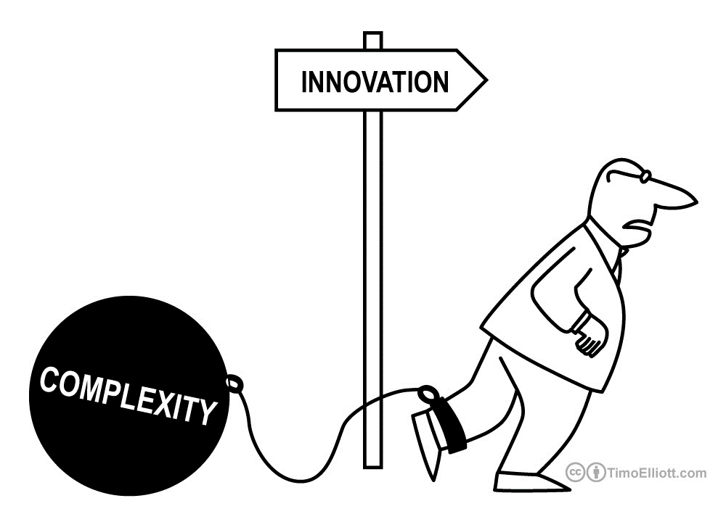
Achieving transformation (at a global level)
Real transformation at a global level is challenging!
4 classes of system leverage points
Harder to achieve, greater effect on system change
4. ‘Parameters’ (e.g. subsidies, taxes, material stocks and flows)
3. ‘Feedbacks’ (e.g. delays, negative and positive feedback loops)
2. ‘Design’ (e.g. structures, incentives, power to self-organise)
1. ‘Intent’ (e.g. goals, mindset and paradigm, ability to change these)
e.g. standards imposed on industry
e.g. time to detecting biosecurity breach
e.g. farmer collective or ‘B-corporation’ structures
e.g. deep agreement on purpose/ethics
Notes:
So how do we achieve transformation at this scale? First, let’s not kid ourselves, this is a challenge in a complex global system! Which is all the more reason to approach it with open eyes.
STAP’s paper summarizes a bit of work on leverage points from the system change literature (also reviewed comprehensively in the GIZ work we’ll hear about shortly). I’m not going to dwell on this in detail, but the essential idea is that different types of levers are less or more effective in driving system change. The ones at the bottom here, focused on changing system design and the intent of the system are the strongest; but the key point is that these ones are also usually the hardest to pull.

Slide 6
Achieving transformation (at a global level)
Real transformation at a global level is challenging!
Strong leverage points are hard to effect
but can be preconditioned by many weaker/easier leverage points (well-targeted ‘small wins’)
Need real transformation ambition to aim at
Go beyond replicating and disseminating to scaling deep and up – the strong levers.
Set pathways & scaling towards success, and monitor
(Not)
Notes:
So it is encouraging to know of a second idea, that systems can be set up to change more easily (that is, be made more ‘transformable’) by pulling a number of weaker levers all in the right direction. This is the idea of many small wins.
You can see this if you think of shifting to a circular economy nationally – getting a massive shift all in one go is hard, so in practice a whole set of small steps like labelling, education, adopting natural capital accounting, and so on have to be in place to allow real change to happen.
The paper elaborates these ideas a bit, but the key point here is that these smaller pathways have to reinforce each other, which means there must be a clear longer-term target or ambition to aim for – not just any ‘small victory counts’!
There’s other material in the paper about processes of scaling, and the one point I’d make here is that real transformation almost always involves going beyond scaling out – that is replicating or disseminating which STAP often sees in PIFs – to scaling both deep and up: that is, changing social norms and goals, as well as changing institutional arrangements – our two strongest levers here.
But now let’s turn to metrics, which we need to let us see quickly whether the pathways are working as intended.

Slide 7
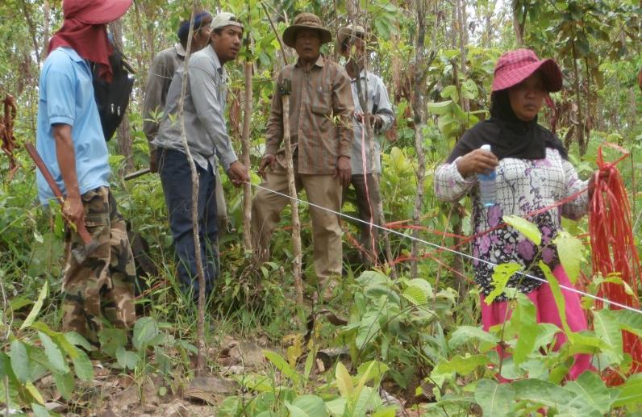
Transformation: metrics for learning and adapting
STAP suggests tracking metrics in each of the following classes of lead indicators for transformation:
Capacity for change
Governance and policies
Multi-stakeholder dialogues
Innovation and learning
Financial leverage
Photo: Recoftc.org
Notes:
OK, so transformation is generally going to be doing some challenging and often novel things; this means they may fail, so we need to be monitoring to confirm there is success or adapt quickly where there is failure. But transformation can take a while, so we need lead indicators, that is, indicators of the processes that mean we are heading in the right direction, linked to our key levers and these issues of achieving scaling deep and up.
The work that GIZ has done provides a wealth of approaches to this question, and our paper summarises these into 5 key classes of indicators that connect with the GEF-8 framing. 4 of these are the levers in the GEF-8 ToC mentioned earlier, and we have added an important extra one from the GIZ work to give these 5.
The extra one is first here -
Capacity for change: tracking whether organizations and other actors have or are developing the capacity for the required change
The other 4 from the GEF-8 theory of change are very congruent with STAP’s enabling elements for good project design:
Governance and policies: Are the expected changes in governance and policies happening?
Multi-stakeholder engagements: Are the right multistakeholder dialogues being maintained and increased?
Innovation and learning: Is innovation emerging, and are learning and knowledge exchange happening?
Financial leverage: Are financial resources being leveraged, and increasing?
STAP is basically suggesting that a healthy monitoring system for transformation will ensure that it is tracking at least some metrics in each of these classes. In practice these will often be quite specific to the system of concern. The GIZ work includes a huge database of possible metrics for different sorts of interventions which is worth looking at once you have your head around the general framing; a few of these are, again, summarised in Annex C of the STAP paper.
[Photo: This is a forest inventory in Cambodia – we’re accustomed to measuring environmental change and you will find some of this in the GIZ lists, but most of these lead indicators are more social and institutional than biophysical.]
The STAP paper identifies some potential indicators for some major GEF projects that are aiming for transformation, and we’ll hear some experiences from two of those shortly to help make this more concrete. But first let’s look quickly at a few examples.

Slide 8
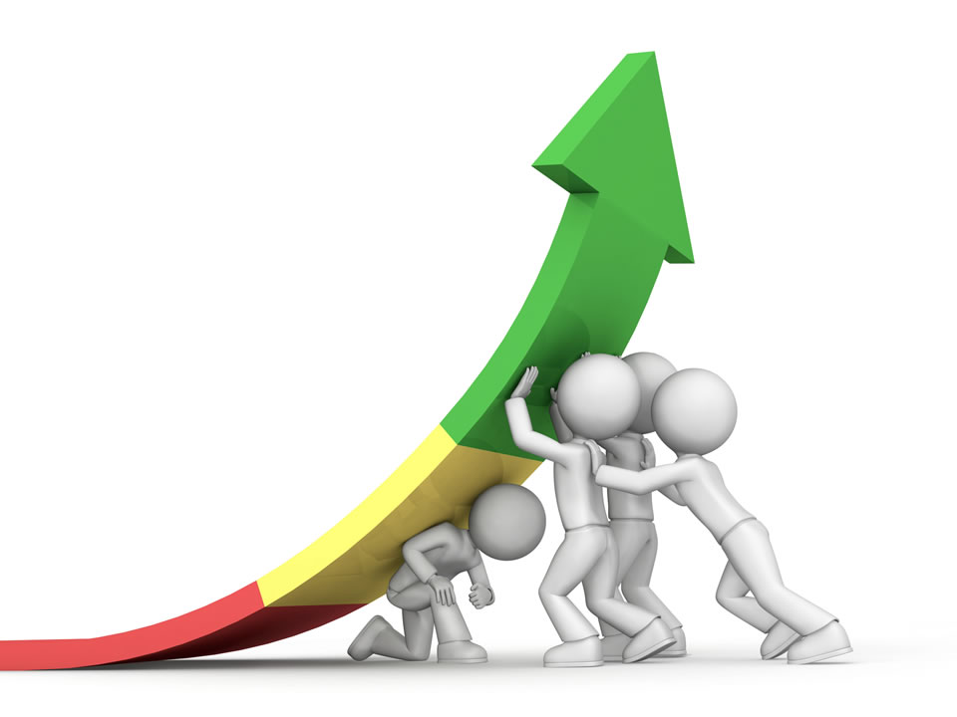
1. Capacity for change
Do the organizations or other actors that need to make changes have the capacity to think about and deliver them? (including the project team itself!)
E.g.:
Capacity to facilitate transformation professionally ()
Degree of integration of different forms of knowledge ()
Number of actors reached (), and level of resistance to the need for the change ()
Notes:
This is about the capacity of individuals, organisations and in fact the whole system (including your project team), to handle the complexity usually associated with transformative change, and to accept the need for change. Obviously if this is low and not increasing, it’s a warning sign.
Change agents often come from outside the current system, so it is important to look widely for them, but it is possible to build the capacity of those that you identify. They might be companies innovating around waste, or just inspirational individuals in your system.

Slide 9
2. Governance and policies
Are the changes in values and in policy, legal, and institutional arrangements that are needed for scaling starting to happen, and are measures reflecting the status quo decreasing?
E.g.:
Degree of dissemination of social norms, memes, narratives, behaviours, etc., up to a global level (e.g. via a value chain) ()
Extent to which the transformation process is capable of proceeding iteratively and adaptively ()
Support for change across multiple levels of governance ()
Notes:
This one is about institutional arrangements and governance as well as social norms and values, changes in both of which are core to transformation as we’ve already seen. It can reflect actual processes of government, such as aligning across levels; but often is about structures that may be outside government, such as inclusion of smallholder farmers in value chain negotiations.
Structures like government agencies or long established industry associations can be very rigid, not permitting the adaptive changes required for transformation. If they are critical actors, can they be changed or replaced?
We are also hearing of efforts in IPs to repurpose policies and incentives to more durable, environmental practices and innovation, thus improving policy coherence. This category should capture progress towards such changes.

Slide 10
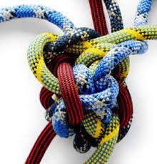
3. Multi-stakeholder dialogues
Are there appropriate forms of support by important stakeholders, including levels of engagement, influence, and learning, while considering vested interests and power dynamics?
E.g.:
Inclusion of different actors in developing interventions ()
Relative influence of past vested interests () and their level of comfort with the changes ()
Notes:
MSDs can take very many forms, from informal engagements to institutionalised bodies; in general, equitable inclusion beyond only governments is important to obtain wide support for change. Who are the key stakeholders in a new system and are they supportive?
Where there are vested interests who may appear to be losers from change, it is just as important to carry them along so they don’t undermine efforts; thinking about compensation and tracking their comfort levels may be crucial for success.

Slide 11
4. Innovation and learning
Are relevant novel technologies, business models and processes emerging, and are appropriate levels of knowledge exchange and learning occurring among actors who need to deploy them?
E.g.:
Extent of learning with and among actors ()
Level of demand for novel products outside program participants ()
Level of relevant discourse on the forms of social justice to be addressed ()
Notes:
Transformation usually involves innovation to move into a new system, and anyway it requires the general uptake of new ways of thinking and operating, so effective knowledge exchange is vital. Ultimately the demand for these new ways of doing things must be increasing, and for real exponential scaling the ideas must be taken up by actors outside the immediate projects or program.
Observing the degree of discussion on areas of knowledge that need new thinking, such as social justice issues, may also be important in context.

Slide 12
5. Financial leverage
Is there evidence of appropriate financial resources increasingly flowing in the directions needed (and away from others), particularly from mainstream public and private sources?
E.g.:
Level of economic incentives (taxes, subsidies, etc.) favouring the new system () vs the old ()
New jobs in the new system () vs jobs lost in the old ()
Notes:
Finally, financial support of some form is usually needed to support scaling and enduring change. This is obviously a major concern in the environmental area at present, and closely tied to issues of policy coherence and repurposing perverse incentives already mentioned. Equally, transformation needs to deliver livelihoods to those involved, even if these are changed. These are areas where watching for change in the old system is as important as in the new.

Slide 13
Some take-aways
Transformation, especially for global outcomes, is challenging!
But there is a growing body of research to support it, both theoretically and practically
Investments seeking transformation should consider tracking some lead indicators in each of at least these 5 categories
Actual metrics should be tailored to the context and sectors of concern
To learn and adapt from these, there must also be regular evaluation and review!
Sources and more in STAP’s Transformation paper (https://www.stapgef.org/resources)
Notes:
So in summary, transformation is genuinely challenging, but there is a growing formal body of work understanding how to achieve it.
It is also uncertain and complex, so it is important to have monitoring and learning around its implementation. Linking the GEF-8 framing with the work of GIZ, STAP urges proponents to plan to track at least one or two most critical aspects of each of the 5 categories of indicators, of course choosing specific metrics suited to the transformation pathways and sectors of the system in hand. When you get that concrete, there is a wealth of general and sector-specific possible indicators in the GIZ database, but you need a framework first.
And of course there is no point monitoring unless you use the information to learn and adapt, so a regular review cycle needs to be set up!
More on this, and references for the sources, including the GIZ document, can all be found in the STAP paper, easily googled. And we’ll hear a bit more from GIZ in a few minutes, as well as the experiences of a couple of GEF initiatives in this area.

Slide 14
Thank you!
Image courtesy of Oma Tafua
Notes:
So we aim to breech transformatively into a better future like these humpback whales that are recovering so well from our centuries of hunting, not least thanks to a transformation of our global marine parks!
[A whale and her calf do a double breach off the coast of Niue. Image courtesy of Oma Tafua.
Source of picture: https://news.mongabay.com/2022/11/small-island-big-ocean-niue-makes-its-entire-eez-a-marine-park/

